Slide 1

Intro to R R for data wrangling

Slide 2
Downloading R and RStudio
Step 1: Download and Install R
Visit the CRAN website: https://cran.r-project.org/ .
Choose your operating system:
Windows: Click Download R for Windows, then click base, and download the installer.
Mac: Click Download R for macOS and download the appropriate version for your macOS.
Linux: Choose your distribution and follow the provided instructions.
Follow the installation prompts to complete the setup.
Step 2: Download and Install RStudio
Visit the RStudio website: https://posit.co/download/rstudio-desktop/ .
Download the free RStudio Desktop version for your operating system.
Windows, Mac, or Linux options available.
Open the downloaded installer and follow the steps to install RStudio.
Step 3: Verify Your Installation
Open RStudio.
Check the Console Panel to ensure R is correctly linked (you’ll see the R version displayed).

Slide 3
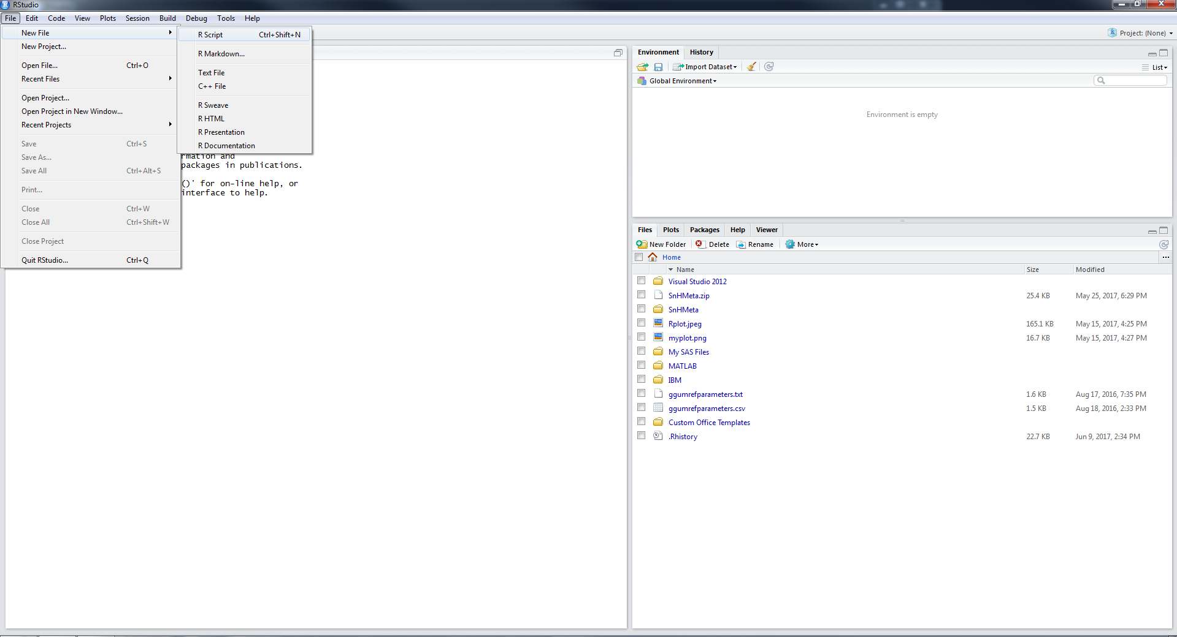
Starting Out
Select new R Script

Slide 4
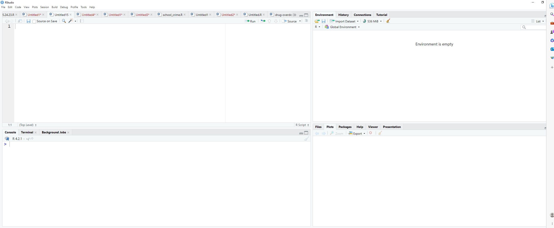
Run whole Script or highlighted section
The editor is where you can write R code that can be saved and reran.
Press CTRL + Enter to run highlighted code
Environment tab shows all active objects.
History tab shows list of commands used so far.
Files tab shows files and folders in your current workspace.
Plots tab shows all your graphs.
Packages tab shows available packages to run certain functions.
Help tab provides additional info.
Viewer tab is built-in browser.
The console is where you see output and can also type R code.

Slide 5
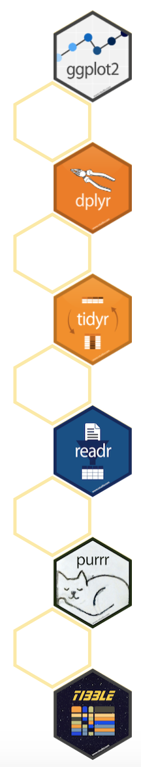
Getting started with packages
Packages are extensions to base R. They contain additional functions, documentation for using them, and sample data.
Packages are available from the Comprehensive R Archive Network (CRAN).
https://cran.r-project.org/web/packages/available_packages_by_name.html
The “tidyverse” is a set of packages for data manipulation, exploration, and visualization. They share a common design and work in harmony.
#Install and load the package 'tidyverse'
install.packages('tidyverse') #only need to run once
library(tidyverse) #run at start of every R session to use
https://www.tidyverse.org/

Slide 6
Important Libraries (not in Base R)
Data Wrangling | Plotting | Descriptive Statistics | Mapping/GIS
dplyr, tidyr, plyr | ggplot2 | Hmisc | tmap & tmaptools
janitor | lattice | psych | ggmaps
tidyverse | patchwork | summarytools | sf
stringr |  | tableone | tidycensus
readr |  | desctable
foreign |  | GGally
remotes
Note: R is case-sensitive. The packages must be typed exactly as shown above.
Note: Libraries contain various functions. If the library is not installed and loaded, you cannot use it. Libraries that come with R by default are called ‘base’ R libraries. They do not need to be installed. They do need to be loaded.

Slide 7
Syntax for libraries (AKA packages)
Developers of different libraries may use the same function name.
Good coding practice to specify package::function() to be explicit:
# Instead of:
filter()
# Specify the package for that function:
dplyr::filter()
library
function

Slide 8
Data structure
Anything that exists is an object
Dataset
The results of a statistical test
Graph
Anything that happens is a function call
R has several types of data values
The most common are in the table
Type | Example
Character | “A”, “b”, “Portland, OR”
Numeric | 2, 15.5
Logical | TRUE, FALSE

Slide 9
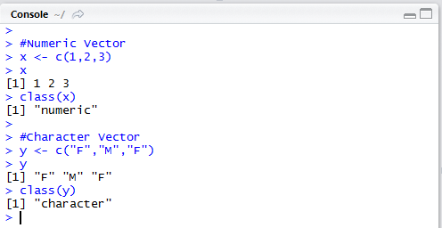
Data Structures
Vector
Values of all same data type
Numeric Character
1
M
2
F
3
M

Slide 10
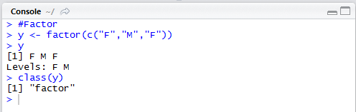
Data Structures
Factor
Collection of values that have fixed set of possible values
Similar to vector
Represents categorical variables
M
F
M

Slide 11
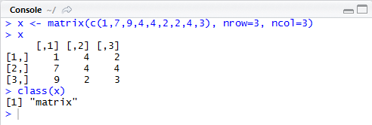
Data Structures
Matrices
Two-dimensional collection of values of same type
Array can extend this to more than two dimensions
1
4
2
7
4
4
9
2
3

Slide 12
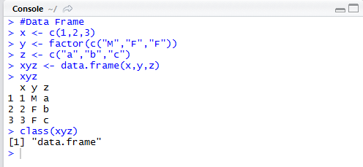
Data Structures
Data frames
Collection of vectors that all have same length
Columns can have different data types
Array can extend this to more than two dimensions
1
M
a
2
F
b
3
F
c

Slide 13
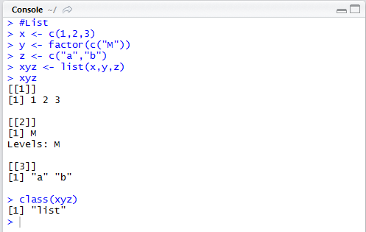
Data Structures
Lists
Similar to data frame, but columns can have varying lengths
1
M
a
2
b
3

Slide 14

Things to Note When Writing Code
Syntax is case-sensitive
Typing in “Mydf” to call an object named “mydf” is wrong
Object names consist of letters, numbers, underscores “_” and periods “.”
You can use either ‘<-’ or ‘=‘ to assign objects value
a <- c(1,2,3)
a = c(1,2,3) ← do not do
Functions can stand on their own or be an object
1 + 2
a <- 1 + 2
Important to consider later on when we do analyses

Slide 15
Your turn: Create a simple dataset in R (by hand)
sex_at_birth <- c(“male”, “male”, “female”, “male”, “female”, “female”)
age <- c(10, 12, 3, 0, 1, 16)
cbl_score <- c(50, 39, 48, 54, 70, 55)
dep_score <- c(40, 29, 37, 44, 60, 45)
total_score <- cbl_score + dep_score
mydat <- data.frame(sex_at_birth, age, cbl_score, dep_score, total_score)
str(mydat)
View(mydat)
Use the ‘str’ command to check what the computer understands to be the contents of your data-this matters when you analyze (‘factor’ plots and adds differently than ‘integer’ or ‘number’)
Things to note
WARNING: DO NOT COPY AND PASTE

Slide 16
table(mydat$sex_at_birth)

Slide 17
Importing Data
R can read a variety of datasets
The most important dataset is a csv file
mydat <- read.csv(“PATH TO FILE”)
mydat <- read.csv(“C:/Users/barboza-salerno.1/Documents/mydat.csv”)
NOTE: R is case sensitive and uses forward slashes
Note: the file NAME must be in quotes
Also, once you type the “/” you can hit the tab key to autofill
mydat <- read.csv("mydat.csv")
mydat <- read.csv("C:/Users/barboza-salerno.1/OneDrive - The Ohio State University/Documents/StatsII/Week 3/mydat.csv”)

Slide 18
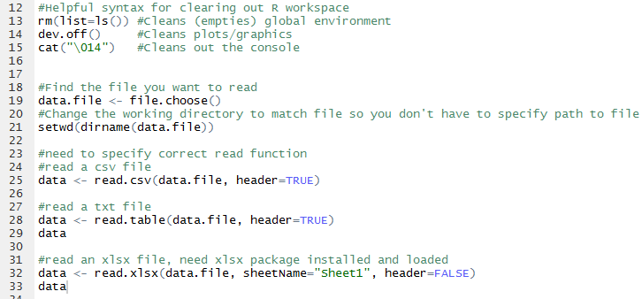
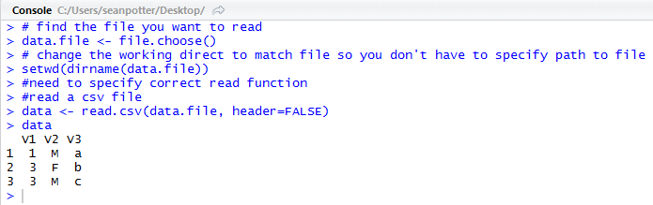
Importing Data Using Syntax
Example .csv import

Slide 19
Other file types
Excel
library(xlsx)
mydat <- read.xlsx(“name of file.xlsx”, sheetName = “Sheet 1”, header = T)
SPSS, STATA, SAS
library(have)
mydat <- read_sav("PATH_OR_URL_TO_SAS_FILE/file.sav")
mydat <- read_sas(" 'PATH_OR_URL_TO_SAS_FILE/file.sas7bdat")
mydat <- read_dta('PATH_OR_URL_TO_STATA_FILE /file.dta')

Slide 20
2. Intro to the tidyverse

Slide 21
The Tidyverse
A collection of packages for data manipulation, exploration, and visualization.
Share a common philosophy of R programming and work in harmony.
Core tidyverse packages:
readr dplyr tidyr ggplot2 tibble purrr

Slide 22

Data Manipulation with dplyr
Very useful package for exploring and managing your data.
“A grammar of data manipulation, providing a consistent set of verbs that help you solve the most common data manipulation challenges.”
Resources for getting started:
http://dplyr.tidyverse.org/
https://cran.r-project.org/web/packages/dplyr/vignettes/dplyr.html
https://www.rstudio.com/wp-content/uploads/2015/02/data-wrangling-cheatsheet.pdf
http://r4ds.had.co.nz/transform.html

Slide 23
3. dplyr code structure

Slide 24
dplyr Key Functions
select()
filter()
arrange()
summarise()
mutate()
group_by()
More helpful info here: https://www.rstudio.com/wp-content/uploads/2015/02/data-wrangling-cheatsheet.pdf

Slide 25

dplyr Key Functions
select()
Picks variables (columns) based on their names.

Slide 26

dplyr Key Functions
filter()
Picks observations (rows) based on their values.

Slide 27
dplyr Key Functions
arrange()
Changes the ordering of the rows based on their values.

Slide 28

dplyr Key Functions
summarise()
Reduces multiple values down to a single summary value.

Slide 29

dplyr Key Functions
mutate()
Adds new variables that are functions of existing variables.

Slide 30
dplyr Key Functions
group_by()
Performs data operations on groups that are defined by variables.

Slide 31
Key Functions
select()
Picks variables (columns) based on their names
filter()
Picks observations (rows) based on their values
arrange()
Changes the ordering of the rows
summarise()
Reduces multiple values down to a single summary value
mutate()
Adds new variables that are functions of existing variables
group_by()
Performs data operations on groups that are defined by variables

Slide 32
Key Operator: The Pipe %>%
A common paradigm in all tidyverse R libraries is to use the pipe operator, %>%, which allows us to chain or pipe functions together
Enables you to pass the object on left hand side as first argument of function on the right-hand side
Goal of making our code more efficient and easier to read

Slide 33
Basic Structure
Use the key functions and pipe to chain together multiple simple steps to achieve a more complicated result.
Dataset %>%
Select rows or filter columns %>%
Arrange or group the data %>%
Calculate statistics or new variables of interest

Slide 34
Basic Structure
#Prints output to the console:
#Creates a new R object:
Dataset %>%
Select rows or columns %>%
Arrange or group the data %>%
Calculate statistics or new variables
new_obj <-
Dataset %>%
Select rows or columns %>%
Arrange or group the data %>%
Calculate statistics or new variables

Slide 35
Infant Mortality Example
You are interested in exploring the relationship between early race and infant mortality in the city of Chicago. You need to find data. You remember that when you were in your research methods couse, you had this amazing professor who told you about the Cook County medical examiner’s case file. You decide to impress your colleagues at the Ivy league school where you were recently tenured. First, begin by downloading, preparing and exploring some key variables by race.
Data manipulation: Create an analytic dataset that is a subset of the observations and variables in the original death data, specific to your research question.
Summary statistics: Explore the variables corresponding to race, and manner of death.

Slide 36
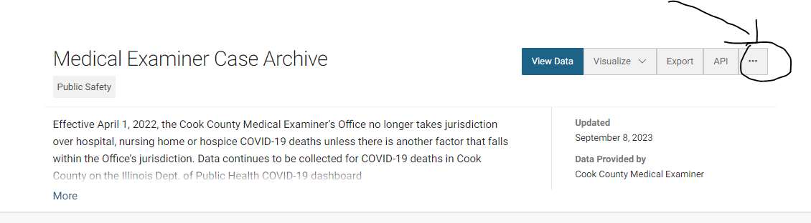
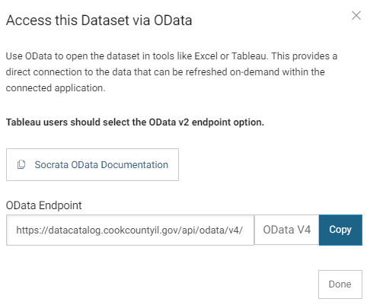
Reading files from the web
Medical Examiner Case Archive | Cook County Open Data (cookcountyil.gov)
https://datacatalog.cookcountyil.gov/api/odata/v4/cjeq-bs86
library(RSocrata)
options(scipen=10000)
#https://datacatalog.cookcountyil.gov/api/odata/v4/cjeq-bs86
infant_mortality <- read.socrata("https://datacatalog.cookcountyil.gov/api/odata/v4/cjeq-bs86")

Slide 37
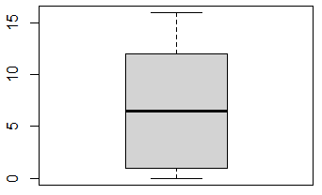
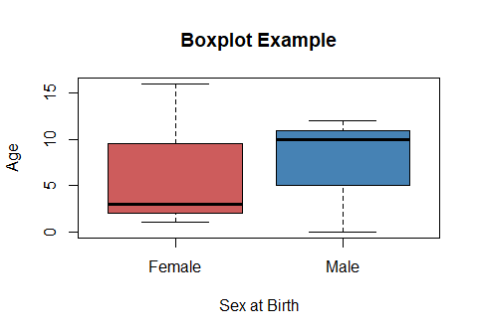
Basic Plotting (Base R)
boxplot(age ~ sex_at_birth,
data=mydat,
ylab="Age",
xlab = "Sex at Birth",
col=c("indianred", "steelblue"),
names = c("Female", "Male"),
main = "Boxplot Example")
The plot and hist functions present users with options to customize their graphs (note: R has extensive help pages or search web for examples)
plot(mydat$sex_at_birth)
Awful
Default: Awful!
Nice!

Slide 38
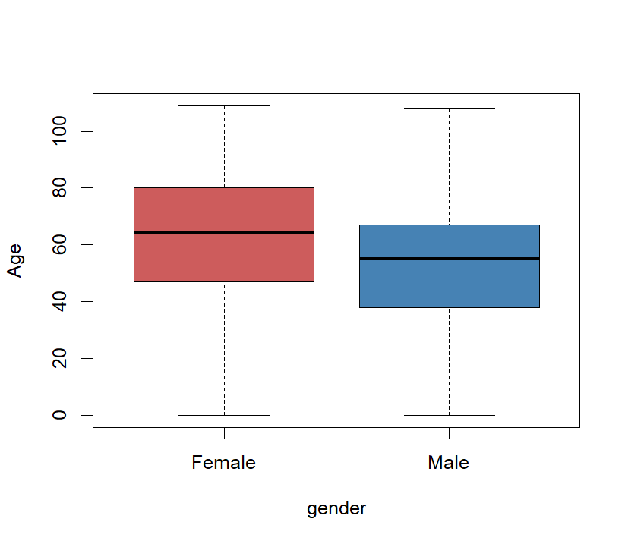
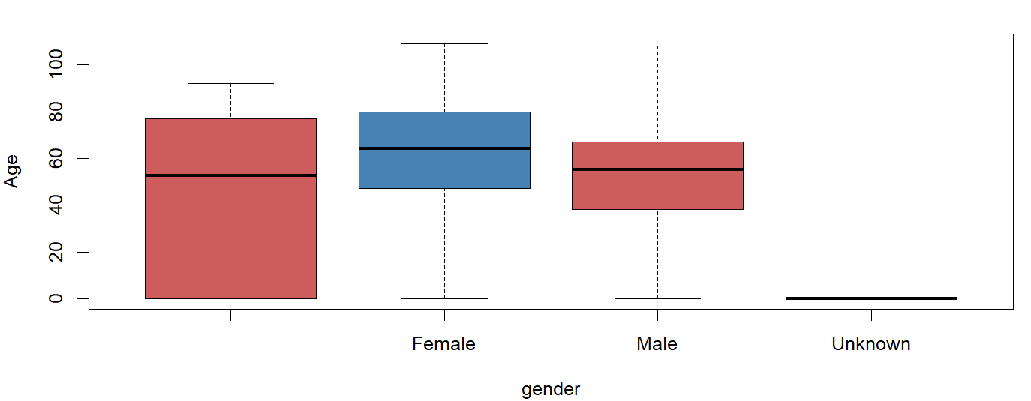
Try at home: Use all of the data (i.e., not infants), and make a box plot of gender and age: Is the median age of death greater for males or females?
boxplot(mortality$age, xlab = "Age", col = "steelblue")
boxplot(mortality$age ~ mortality$gender, ylab="Age")
boxplot(age ~ gender, data=mortality, ylab="Age")
boxplot(age ~ gender, data=mortality, ylab="Age", col="steelblue")

Slide 39
Sources of Spatially Referenced Data
Data Source | URL | Measures
The Urban Institute | Education Data Explorer | Enrollment, Disability, Race/Ethnicity, Income, Discipline
The United States Census Bureau | American Community Survey | Educational attainment
National Center for Education Statistics | Education Demographic and Geographic Estimates | School- and District- level data, social and economic characteristics

Slide 40
Other Relevant Data Sources
Data Source | URL | Measures
EPA | National Walkability Index | Intersection density: Street intersection density (pedestrian-oriented)
EPA | Access to Jobs and Workers Via Transit | Accessibility index: An index of the relative accessibility of a block group compared to other block groups in the same metropolitan region
EPA | Smart Location Database | Development, diversity of land use, street network design
Centers for Disease Control | SVI Data & Documentation Download | Place and Health - Geospatial Research, Analysis, and Services Program (GRASP) | ATSDR | Neighborhood Social Vulnerability: Socioeconomic, Housing, Household, Health and Racial/Ethnic Vulnerability
United States Department of Agriculture | USDA ERS - Data Feature: Mapping Food Deserts in the U.S. | Food deserts: Limited access to supermarkets, supercenters, grocery stores, or other sources of healthy and low-cost food
Transit Center | Home – TED | Accessibility to Neighborhood Amenities including colleges and universities, hospitals, urgent care, parks, and supermarkets
Death data | Medical Examiner-Coroner, Child Deaths dataset | County of Santa Clara (sccgov.org) | Deaths from all causes and manner of death (e.g., homicide, suicide)

Slide 41
Data Source | URL | Measures
Department of Housing and Urban Development | Environmental Health Hazards Index | Exposure to harmful toxins based on a combination of standardized EPA estimates of air quality carcinogenic, respiratory and neurological hazards
Environmental Justice | Environmental Protection Agency | Environmental (e.g., particulate matter 2.5, ozone concentration, air toxins, proximity to traffic, hazardous waste) and demographic risk
University of Richmond | Redlined Neighborhoods | HOLC scores
Center for Neighborhood Technology (CSV) | Housing + Transportation Index | Tons of variables about housing and transportation
Neighborhood atlas | Area Level Deprivation Index | Economic inequality and wellbeing, educational attainment, financial strength
American Forests | Tree Equity Index | Tree equity scores, heat extremity, heat disparity
Trust in Public Land | ParkServe | Park equity
Google | Buildings/Parcels | Building footprints by type (e.g., residence)
Housing | The Eviction Lab | Eviction filings and evictions
Notes:
epa.gov/ejscreen/download-ejscreen-data

Slide 42
Data Source | URL | Measures
U.S. Census Bureau | Longitudinal Employer-Household Dynamics OnTheMap | Workforce indicators, job flows, origin-destination employment statistics, + more
Consumer Financial Protection Bureau | Home Mortgage Disclosure Act Data | Loan origination data
Urban Institute | Spatial Equity Data Tool (urban.org) | Upload and analyze your own data!
Chicago | City of Chicago | Data Portal | City of Chicago | Data Portal | All types of data
Los Angeles | DataLA: Information, Insights, and Analysis from the City of Angels | Los Angeles - Open Data Portal
Boston | Welcome - Analyze Boston
Atlanta | Department of City Planning GIS
Substance Abuse and Mental Health Services Administration | Home - FindTreatment.gov | Substance use, BP, mental health and opiod-related treatment providers
ANSIRH Abortion Facility Database | Abortion Facility Database | ANSIRH | Abortion providers in the US
Notes:
Note, many of these websites have mapping capabilities that allow you to make maps from the site without downloading the data

